Slide 1
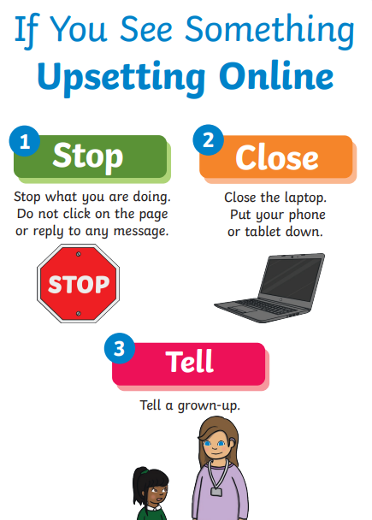
E-safety slides – EYFS

Slide 2
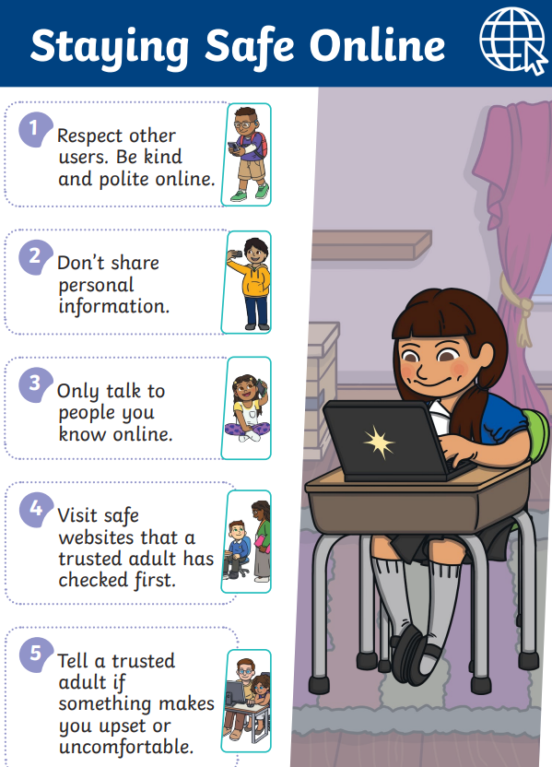
E-safety slides – KS1

Slide 3

E-safety slides – KS2

