Slide 1


Year 4 multiplication tables check

Slide 2
What is the multiplication check?
The multiplication tables check (MTC) is statutory for primary schools in the 2023/24 academic year.
The purpose of the MTC is to determine whether pupils can recall their times tables fluently, which is essential for future success in mathematics. It will help schools to identify pupils who have not yet mastered their times tables, so that additional support can be provided.
Schools will have a 3-week check window in June to administer the MTC. Teachers will have the flexibility to administer the check to individual pupils, small groups or a whole class at the same time.

Slide 3
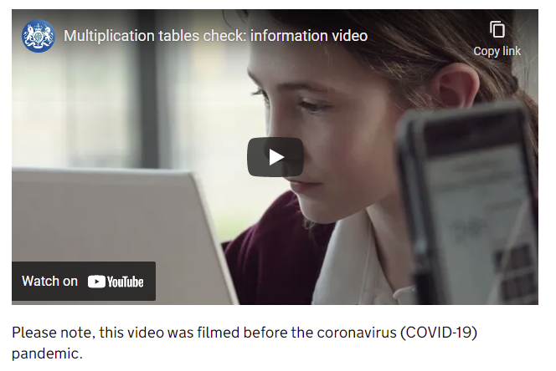
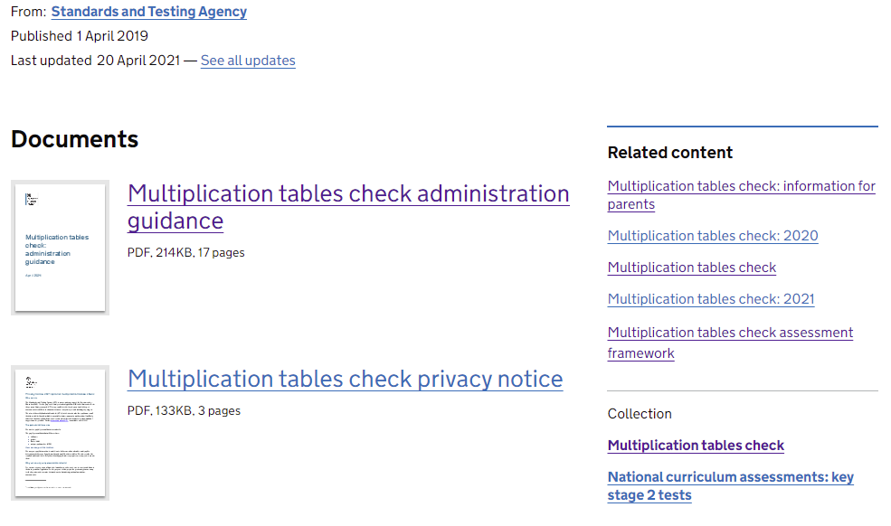
https://www.gov.uk/government/collections/multiplication-tables-check

Slide 4
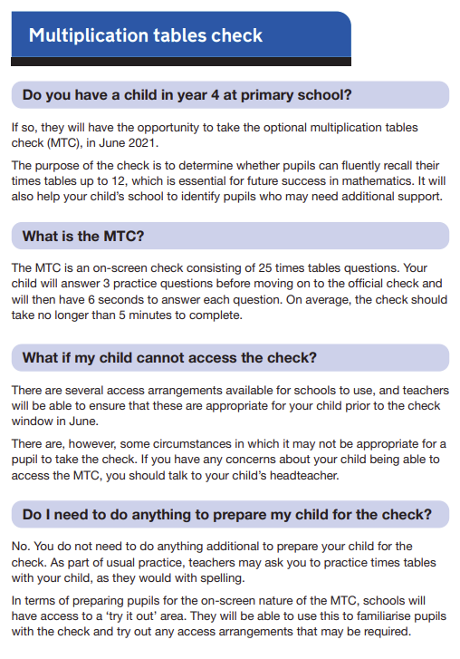
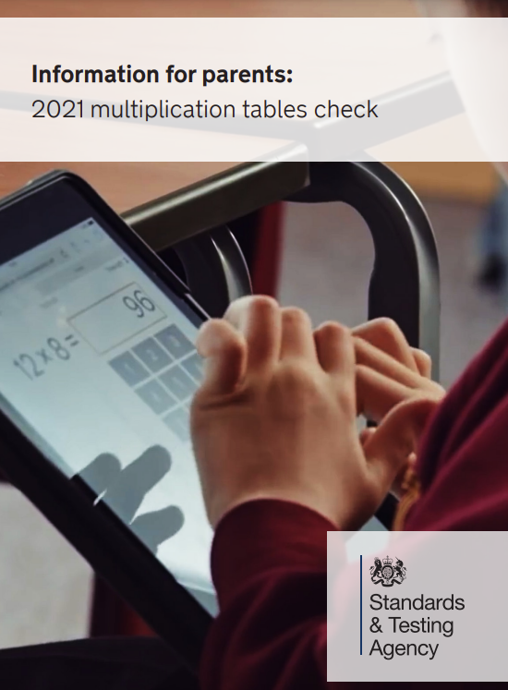
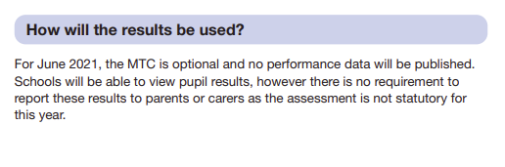
https://www.gov.uk/government/publications/multiplication-tables-check-information-for-parents

Slide 5
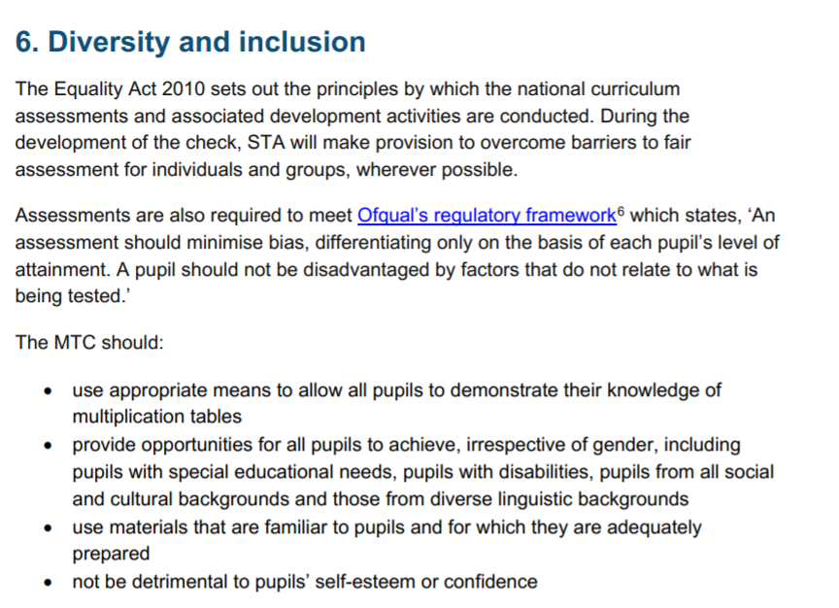

Slide 6
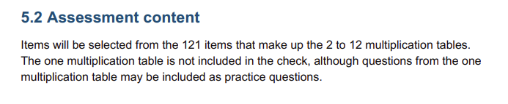
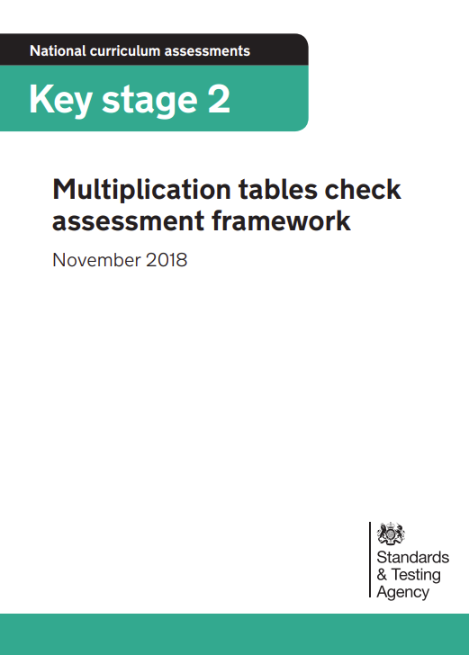
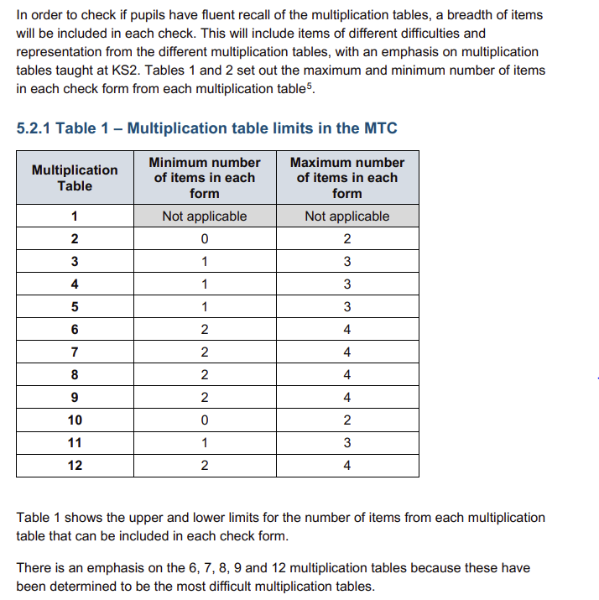
https://www.gov.uk/government/publications/multiplication-tables-check-assessment-framework

Slide 7
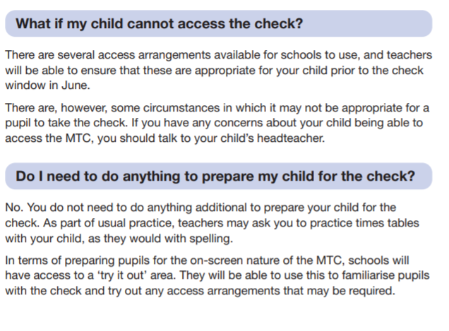
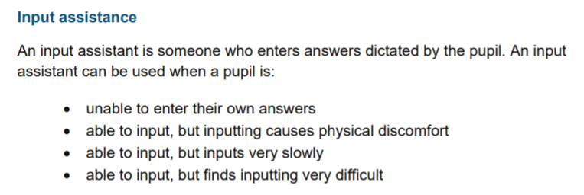
Different font size
Pause/next button between questions
Audio version
Input assistant

Slide 8
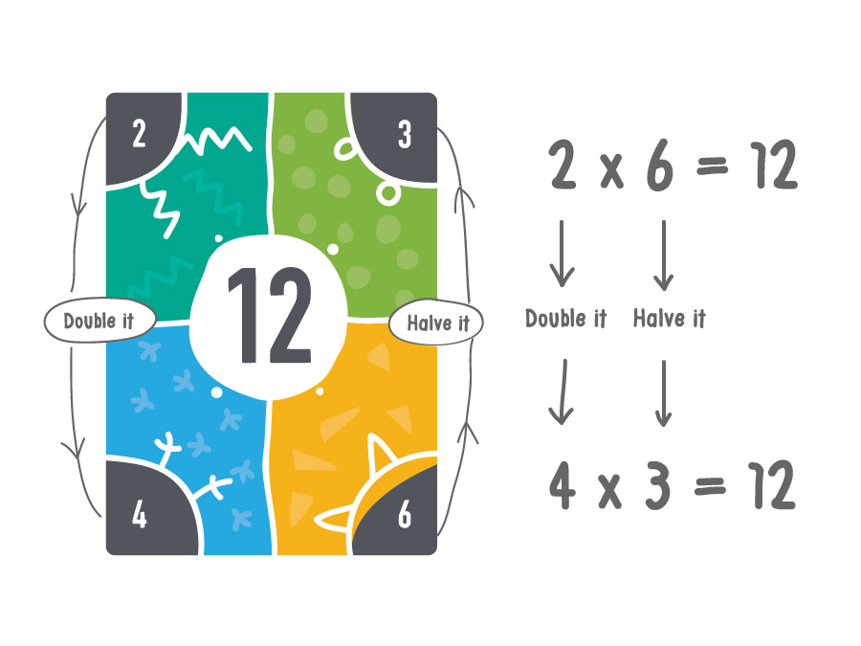
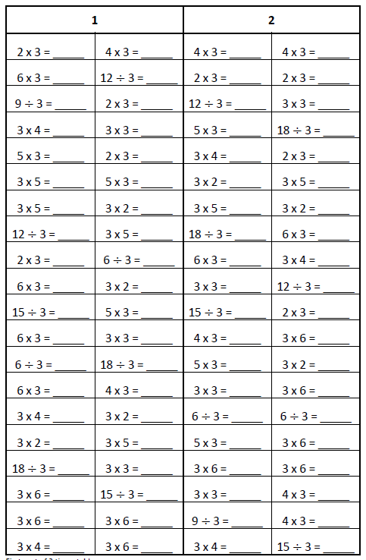
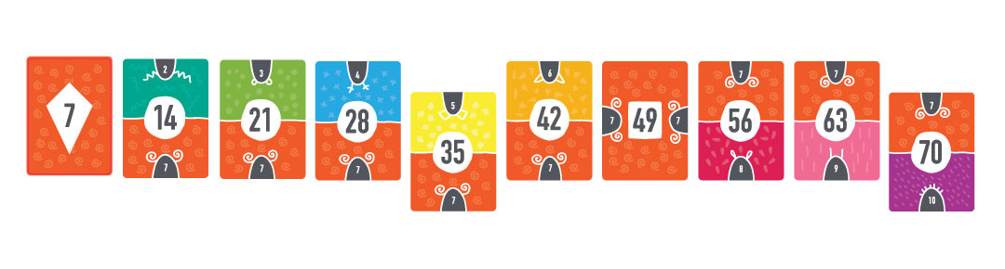
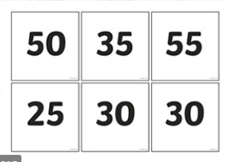
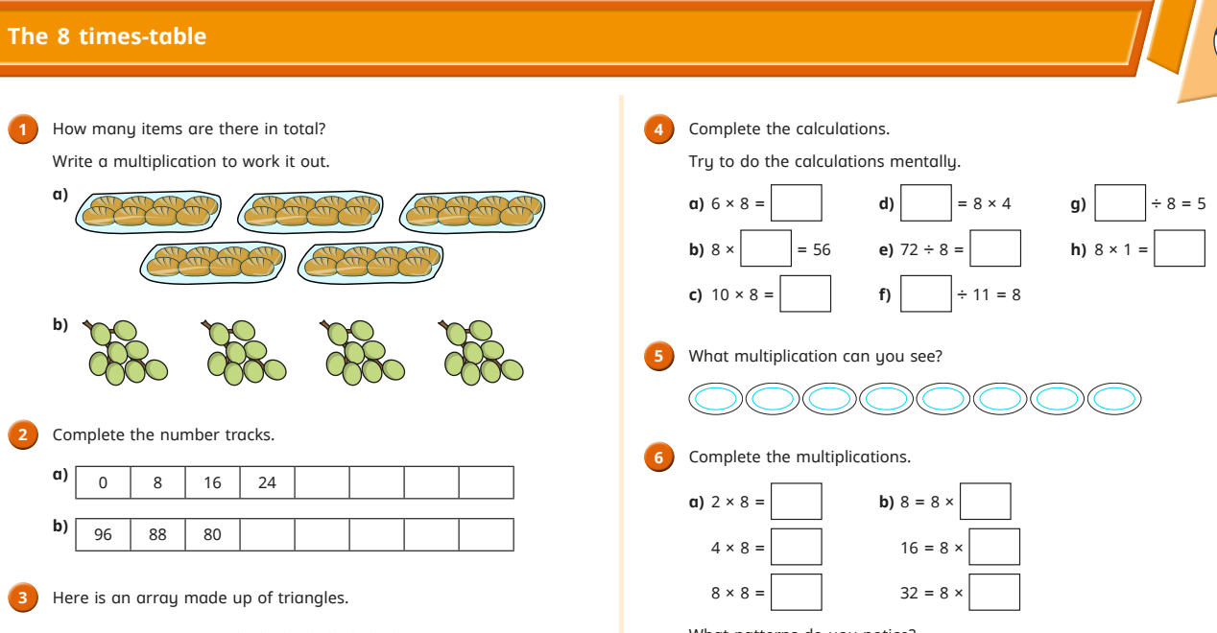

What we are doing in school to support the children

Slide 9
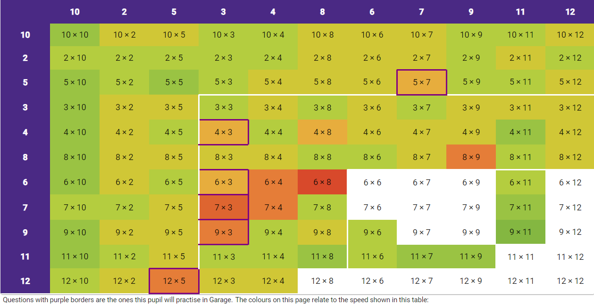
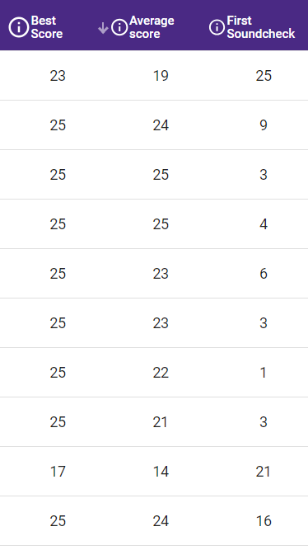
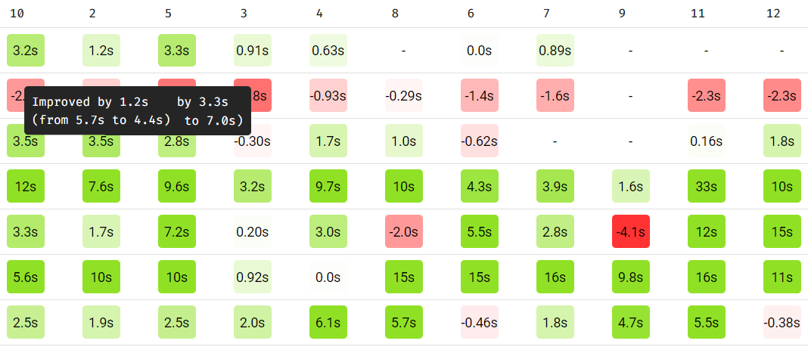

Slide 10
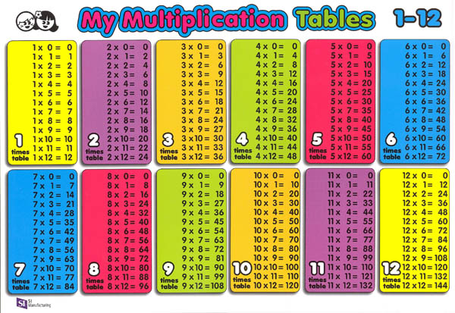
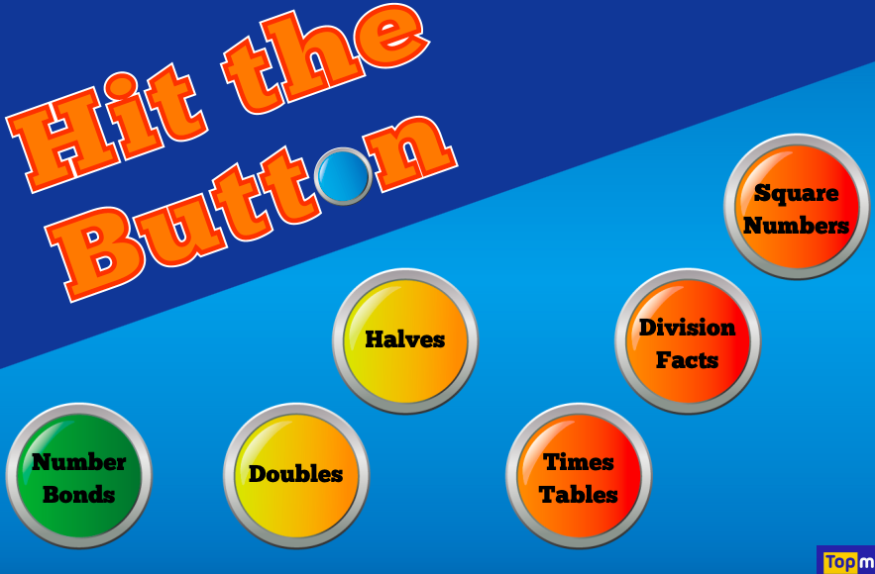
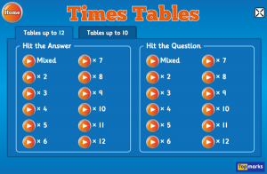
How you can support your child at home
https://ttrockstars.com/parents/

Slide 11
Hit the button https://www.topmarks.co.uk/maths-games/hit-the-button
https://ttrockstars.com/

