Slide 1
E-safety / Safer Internet Afternoon
The Internet gave us access to everything; but it also gave everything access to us.
James Veitch.

Slide 2
Purpose
Give you an opportunity to work with your child(ren) in school
Show you how we help the children develop an understanding of how to be safe online

Slide 3



Notes:
Safer Internet Day is held every February all around the world. Last year over 170 different countries celebrated the day! Safer Internet Day is a chance to think about any worries we might have about using technology and the internet, but it’s also about celebrating all the fantastic things technology can help us with.
Last year, over half of the children in the UK heard about or joined in with Safer Internet Day.
Did you do anything to celebrate the day?

Slide 4








What will our young people think about the internet / being online?
Notes:
We want this year’s Safer Internet Day to be the biggest and best celebration yet! It’s so important to recognise all exciting and amazing things we can do online… maybe you like to play games, or chat with your friends. Maybe you use the internet to learn new things, or maybe you love watching videos.
What’s your favourite thing to do online?

Slide 5

y
S
r
t
a
hi
c
n
s
ee
s
g
i
n
l yi
g
u
l
n
B
e
n
i
l
n
s
O
w
e
n
s
e
m
k
a
a
F
c
S
Notes:
Although there are lots of incredible things to do online, the internet isn’t perfect and sometimes people use it in ways that are not safe, kind or responsible. Maybe you or your friends have seen things go wrong online. Safer Internet Day is a good chance to think about online issues, and what we can all do to make the internet a safer place.
What online issues have you seen or heard about?
[Note to educators: if a learner discloses something that might be a safeguarding concern, then follow the recommend procedures within your setting. For further advice on handling disclosures visit: childnet.com/safeguarding]

Slide 6
Agreement with the Children
Children all sign an ‘Acceptable Use Agreement’
This reminds them of expectations when using technology

Slide 7
KCSIE (Keeping Children Safe in Education)
Refers consistently to e-safety throughout the document
This year a major change to the document refers to the filtering and monitor of information children can access
Effectively this refers to our management of what children can access at school
This is managed externally by our website services – and is then reported to the school should the service deem it to have breached our agreement.

Slide 8
What do we do at school?
Include acceptable use info reminder in the presentation
Highlight that KCSiE has been updated to include stricter monitoring and filtering guidance
Examples of how ‘Teach Computing’ Scheme teaches online safety explicitly.
Hints and tips for safer online use at home
Guidance on amount of screen time for children
Reminder of age limits for apps
Sessions like today
Jigsaw (PSHE lessons)
Digi Crew
Child Friendly search engine (Swiggle)
Use a Computing scheme (TeachComputing)
Enhance our curriculum with the use of technology
Assemblies

Slide 9
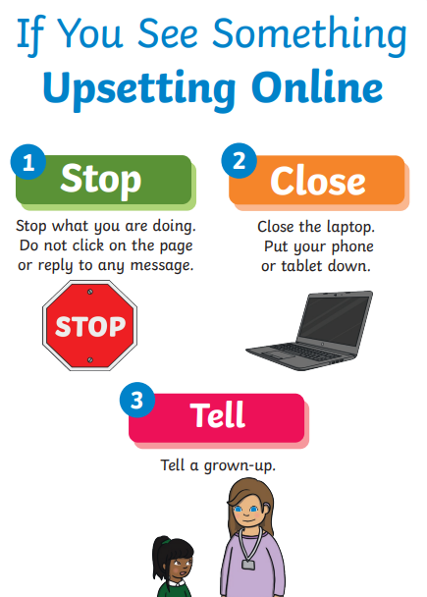
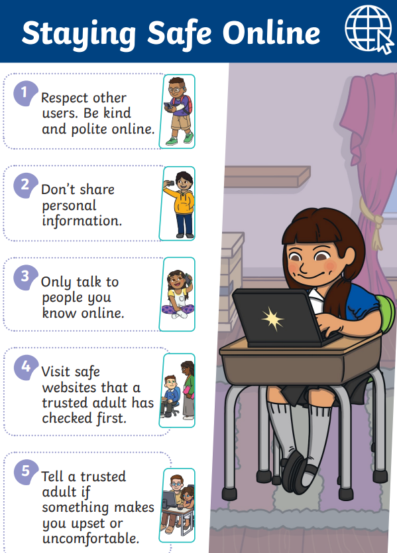

KS1 LKS2 UKS2

Slide 10
Outside of school – How to know what is appropriate?
Content – what is posted / included and are there any controls to limit the type of content seen. Does a game have violent content.
Contact – who can message them, or who are they playing games with. Can you limit this in the settings.
In-app purchases – this can be a way of enhancing gameplay or advancing through levels. Look at the settings to turn off in-app purchases.
Advertising – consider if the ads that are shown suitable for your child. You can report inappropriate ads to the ASA.

Slide 11
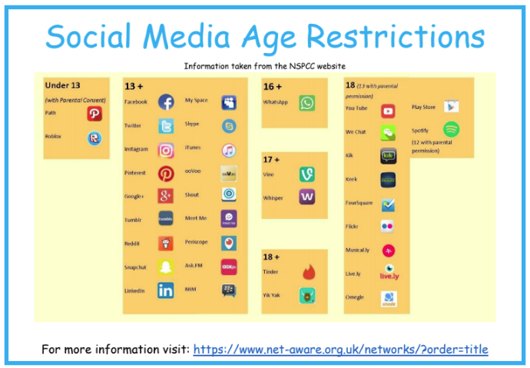

Slide 12
Online Safety Bill
There is an incoming bill that will protect children from online harm, but this doesn’t mean that we can afford to take our eye off the ball.
This will have a massive effect on social media, companies will be forced to keep underage children off their platforms, anyone under the age of 13.

Slide 13
In the classroom
You will be joining classes and complete a few different activities with your child(ren)
They are likely to have already started so jump in and find out what they know and what they are up to

Slide 14
Thank you for coming!
Please take a feedback form from the classrooms
And leave it with the office.

