Slide 1
E-safety / Safer Internet Afternoon
The Internet gave us access to everything; but it also gave everything access to us.
James Veitch.

Slide 2
Purpose
Give you an opportunity to work with your child(ren) in school
Show you how we help the children develop an understanding of how to be safe online

Slide 3
Agreement with the Children
Children all sign an ‘Acceptable Use Agreement’
This reminds them of expectations when using technology

Slide 4
KCSIE (Keeping Children Safe in Education)
Refers consistently to e-safety throughout the document
This year a major change to the document refers to the filtering and monitor of information children can access
Effectively this refers to our management of what children can access at school
This is managed externally by our website services – and is then reported to the school should the service deem it to have breached our agreement.

Slide 5
What do we do at school?
Sessions like today
Jigsaw (PSHE lessons)
Digi Crew
Child Friendly search engine (Swiggle) - https://swiggle.org.uk/
Use a Computing scheme (TeachComputing)
Enhance our curriculum with the use of technology
Assemblies

Slide 6

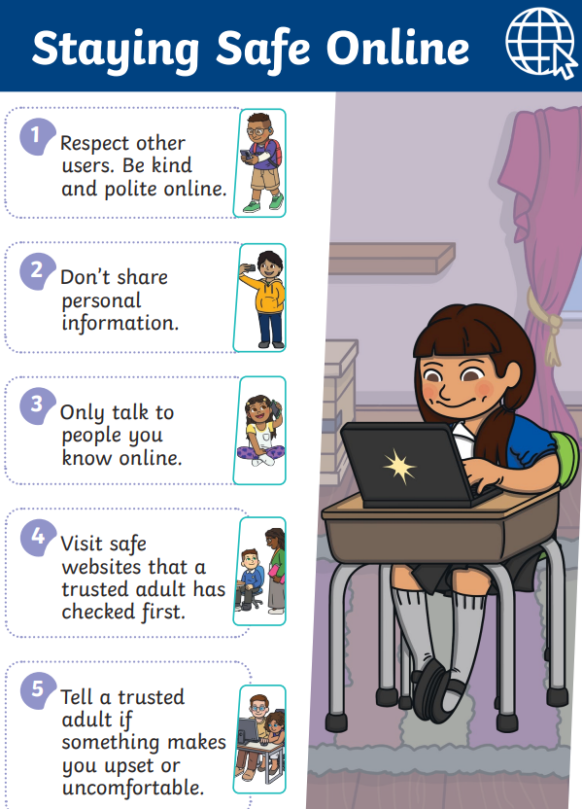

KS1 LKS2 UKS2

Slide 7
Outside of school – How to know what is appropriate?
Content – what is posted / included and are there any controls to limit the type of content seen. Does a game have violent content.
Contact – who can message them, or who are they playing games with. Can you limit this in the settings.
In-app purchases – this can be a way of enhancing gameplay or advancing through levels. Look at the settings to turn off in-app purchases.
Advertising – consider if the ads that are shown suitable for your child. You can report inappropriate ads to the ASA.

Slide 8
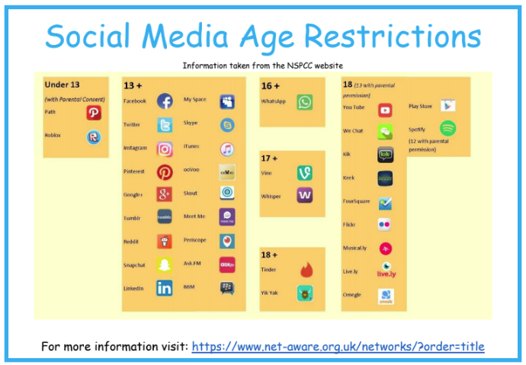

Slide 9
Online Safety Bill
There is an incoming bill that will protect children from online harm, but this doesn’t mean that we can afford to take our eye off the ball.
This will have a massive effect on social media, companies will be forced to keep underage children off their platforms, anyone under the age of 13.

