Slide 1
Phonics
An introduction

Slide 2
Systematic Synthetic Phonics
Phonics is a way of teaching children to read by introducing letters and their correlating sounds.
It is taught systematically, children are gradually introduced to more ways of spelling sounds and each phase builds on existing knowledge.
In phonics, instead of looking at each letter as making an individual sound we look at how combinations of letters can produce sounds.
For example ‘ear’ is one sound, one syllable and one word but made up of 3 letters.
Using phase 2 and 3 sounds we can make a variety of words:
Hear, tear, fear, shear.

Slide 3

Little Wandle
Little Wandle is the main scheme that we use to support the children's phonics.
We use it for daily lessons for EYFS as well as year 1.
If children are falling behind it provides support through ‘daily keep up’ programme to keep boosting their phonics knowledge.
It also supports interventions using rapid catch-up for children in years 2,3,4,5 and 6 who didn’t pass their phonics screening in year 1.
All our staff are trained to best support our children by using the corresponding phase books in order to apply their learning.

Slide 4
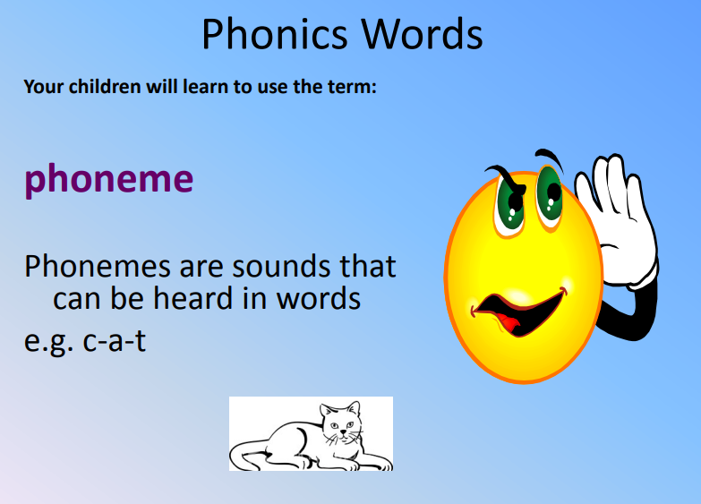

Slide 5
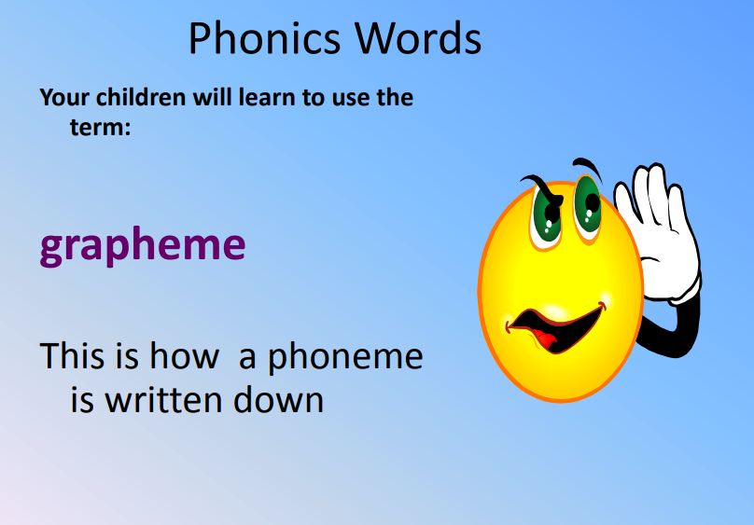

Slide 6
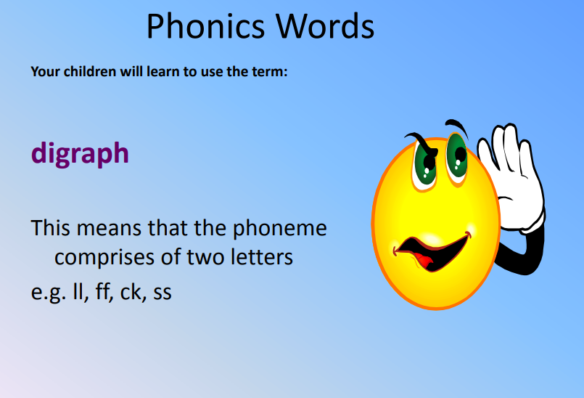

Slide 7
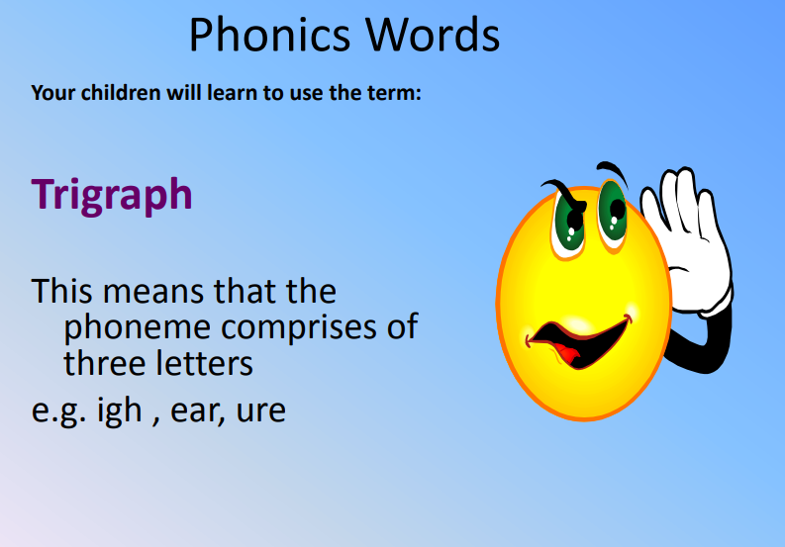

Slide 8
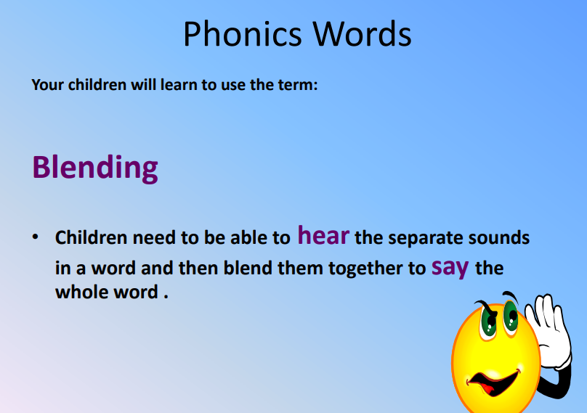
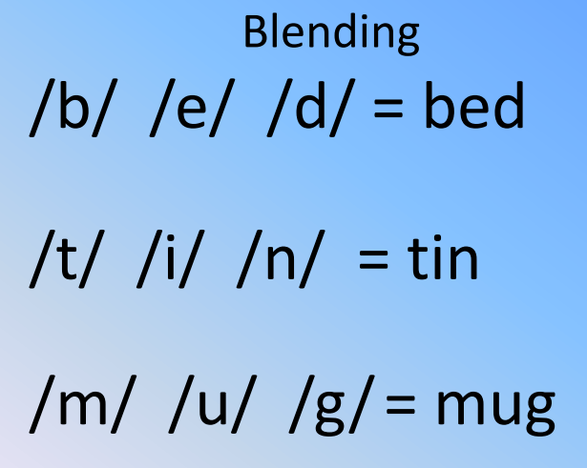

Slide 9
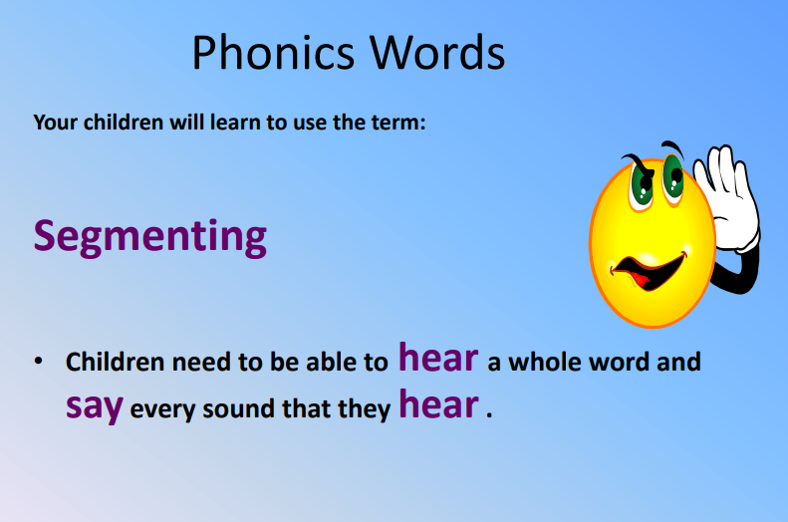

Slide 10
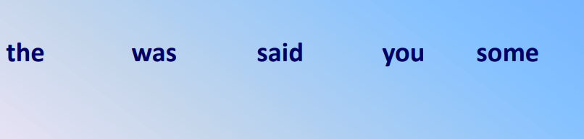
Tricky Words These are words that do not follow the usual segementing and blending pattern. We encourage children to practise raeding these as sight words but we also talk about the ‘tricky’ part of the word.

Slide 11
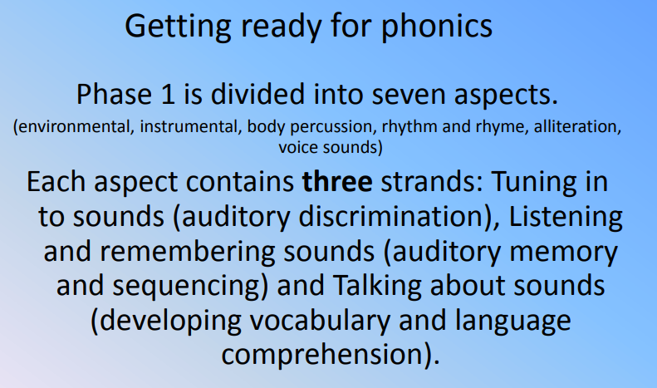
Phase 1

Slide 12
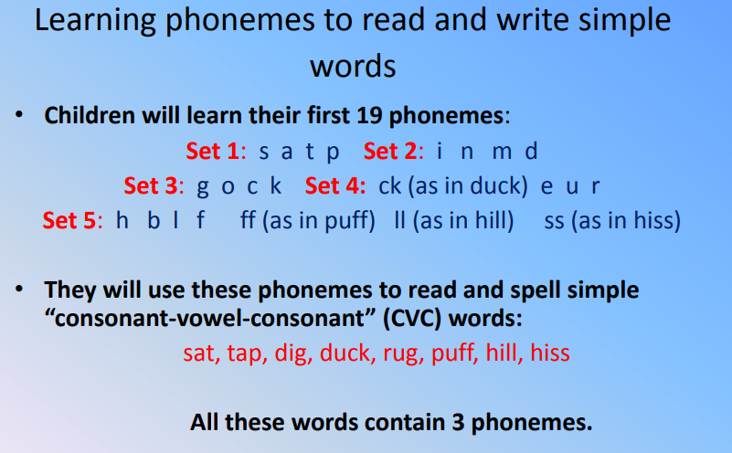
Phase 2

Slide 13
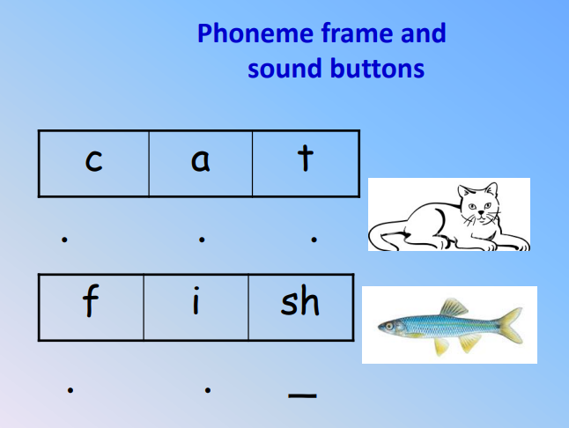

Slide 14
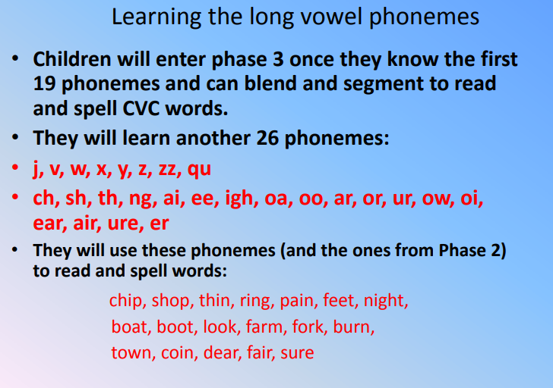
Phase 3

Slide 15
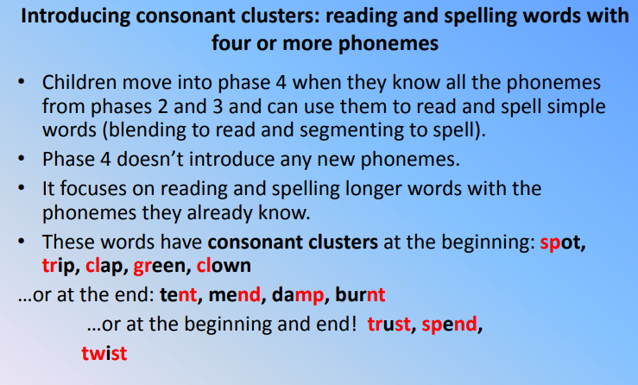
Phase 4

Slide 16
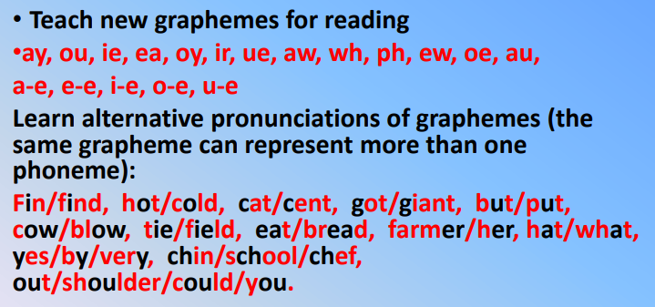
Phase 5

Slide 17
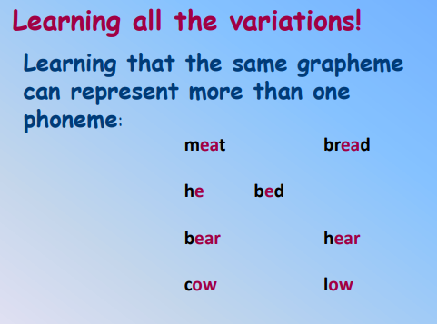
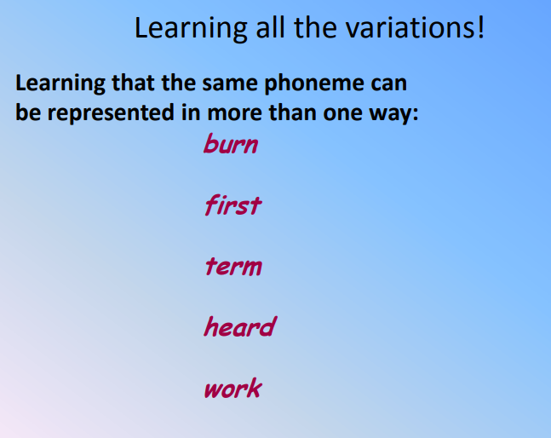
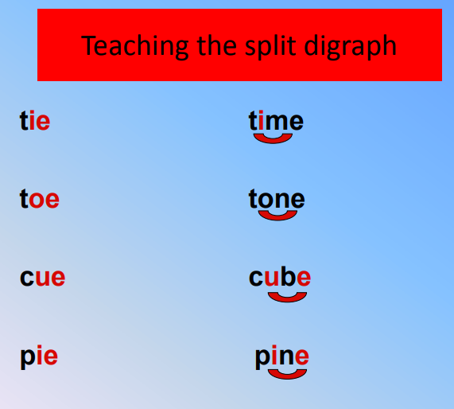

Slide 18
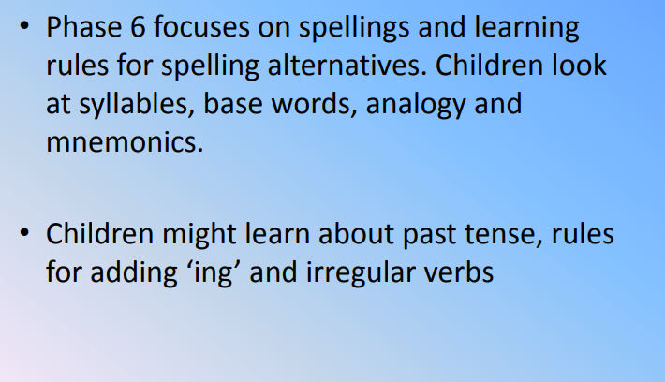
Phase 6

Slide 19
What does Phonics look like In Armstrong mn
Start with the sound – whole class
Apply the sound in group blending
Independent blending
Tricky words
Apply it in a sentence
Throughout the day there will be at least one phonics activity included in carousel learning

Slide 20
Phonics screening
The phonics screening test will happen in term 2 for year 2 and in term 6 for year 1.
It is set by the government to measure reading ability.
The pass rate has been 32 out of 40 for the last 5 years but may change (although considered unlikely).
It a quick word reading exercise 1:1 with the teacher.
There are a variety of real and pseudo words to read.

Slide 21
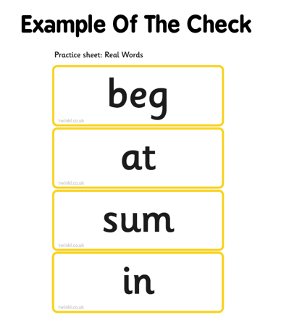
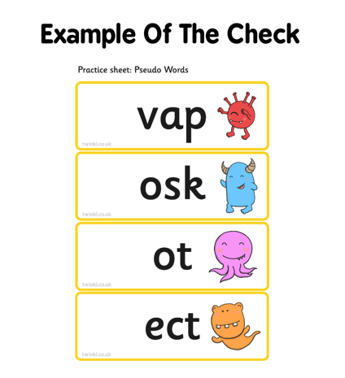

Slide 22
Support In School
Interventions:
In school we have interventions to support children’s phonics.
We have daily keep up to support children on a daily basis.
We also have rapid catch up throughout the school to support children who didn’t pass their phonics screening in year 1.
Reading groups:
In year 1 we have reading groups every day.
The children have been placed in their relevant phase groups.
From this we read the appropriate phase book.

Slide 23
To support At home
Reading regularly is one of the best things you can do to support your child, sharing books, looking at sounds and discussing stories will build up confidence, fluency but most importantly enjoyment!
Practising recognising the phonics sounds
Playing games
Writing in reading records
Practising tricky words

