Slide 1
Reading Workshop
09.10.23

Slide 2
For IC not to put up
We will be talking about the whole of reading in or school because it does vary within year groups – with children focusing on phonics and others fluency

Slide 3
What do we do at Pucklechurch?
Year 1- 6 take part in whole class and guided reading
EYFS focus on 1:1 reading and then moving onto group reading when the child is ready
1 x week we focus on reading in small groups
In Reception and KS1, phonics is thoroughly embedded and used as a predominant teaching tool.
We use a range of activities from text marking, comprehension questions, word definitions, role on the wall characters
Our key skills are: prediction, retrieval, explain, summarise, inference, author choice, apply a range of skills
We are able to use a range of texts in addition to our high quality text

Slide 4
Little Wandle Phonics Scheme
The progression of Little Wandle Letters and Sounds Revised has been devised so that children are taught a progression of sounds that they immediately practise through oral blending, reading and spelling words and sentences, and, later on, reading fully decodable books.
We are teaching children skills to decode words when reading independently. This is through a variety of techniques.
Phonics is a key tool which can be used from Reception to Year 6.
Breaking up words using phonics
Eg make m a_e k
girl g ir l
Breaking words up using root words and suffixes
Eg walking walk ing
adventurous adventure ous

Slide 5

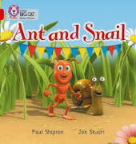
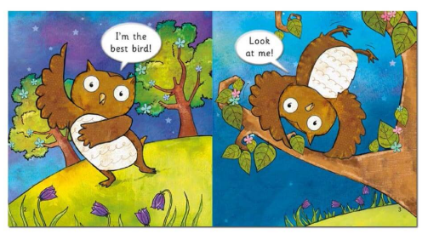
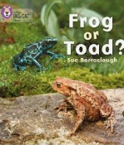



Big Cat phonics

Slide 6










High Quality Texts
In English we use high quality books and creative teaching approaches.
This approach aims to engage and motivate children in their English learning.
It also enables children to deepen their understanding of texts and provides a meaningful context for writing.
We have introduced this approach into reception all the way through to Year 6.

Slide 7
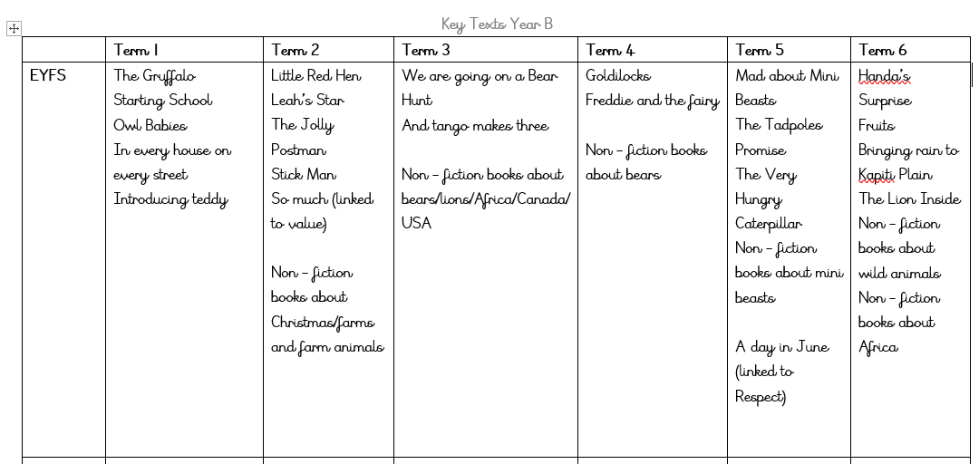
Texts Overview

Slide 8
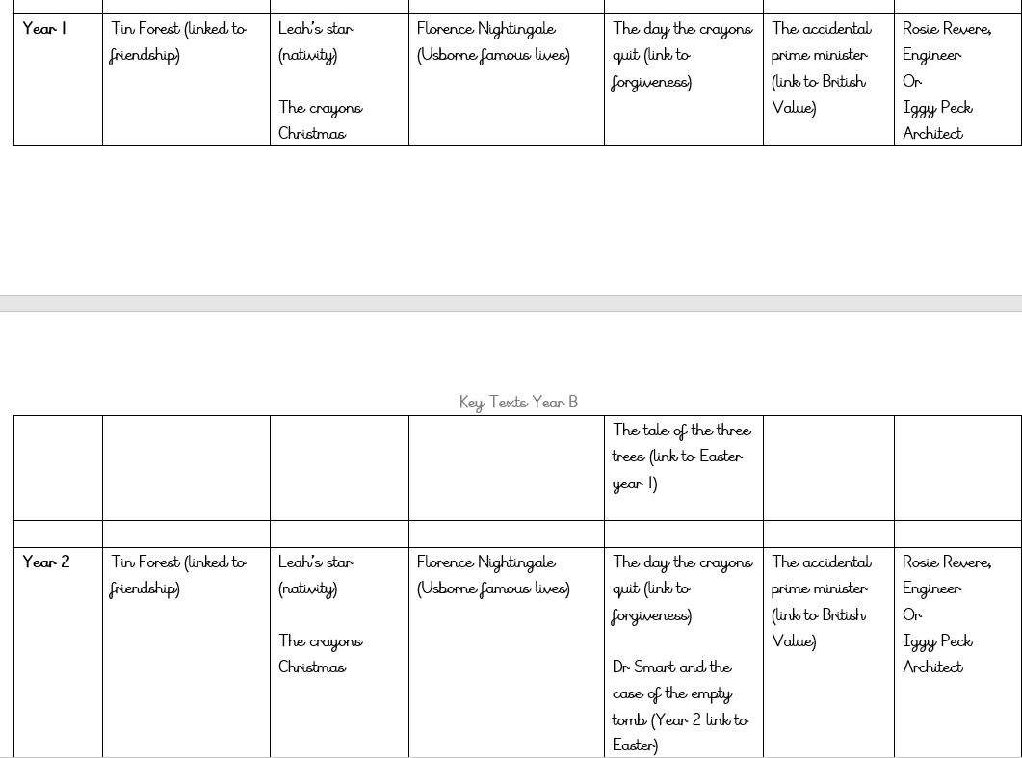
Texts Overview

Slide 9
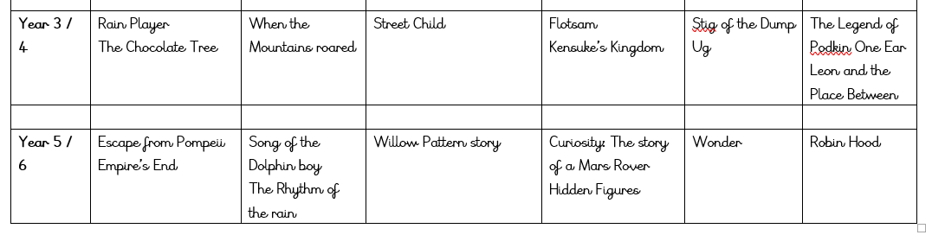
Texts Overview

Slide 10
Guided Reading
Completed in a small group weekly and recorded in reading records
We use a range of texts to ensure children are experiencing a broad range and we are targeting the required skills
Project X books
In these sessions we don’t just focus on fluency, sometimes fluency doesn't match comprehension, reasoning etc
We focus on the following skills - prediction, retrieval, word recognition/understanding, summarise, inference
It is important that children can articulate what they have read as well as read the texts

Slide 11
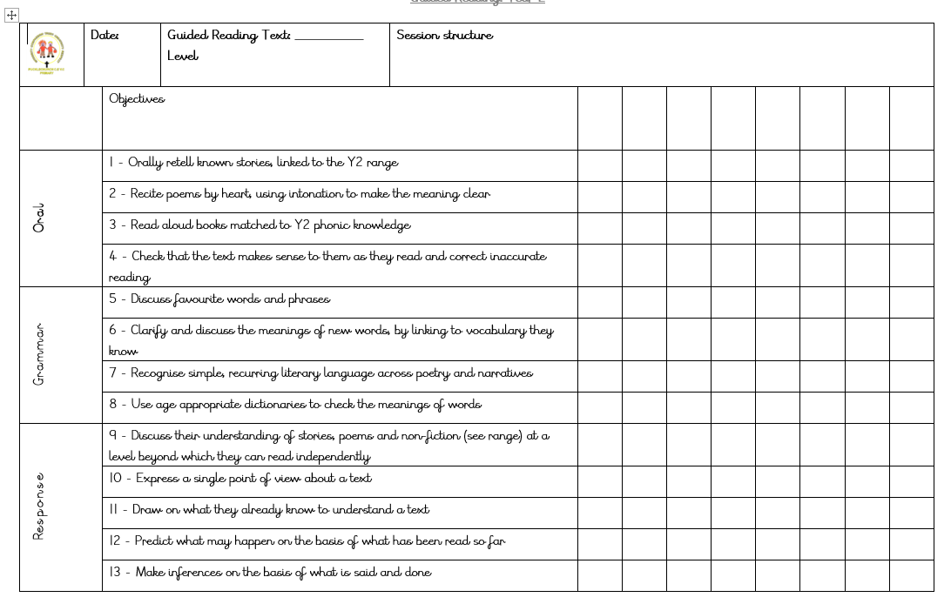

Slide 12
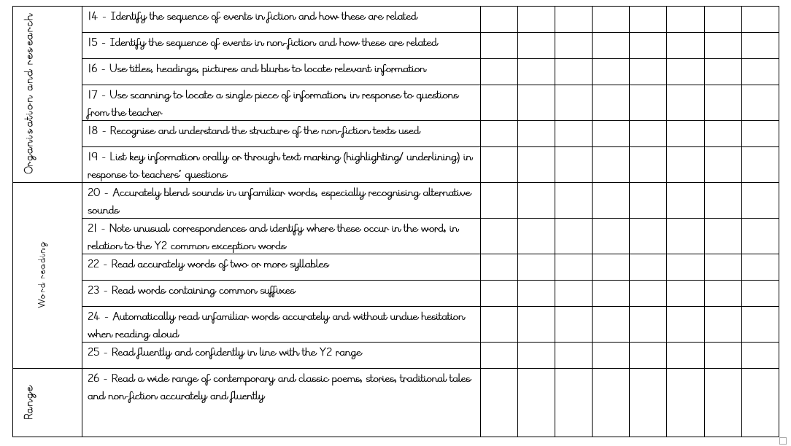

Slide 13
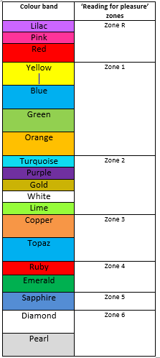
Book Levels
Each week the children should bring home:
1x levelled book
1x zone book
Children will not move up unless they are demonstrating all of the skills
Fiction and Non-fiction

Slide 14

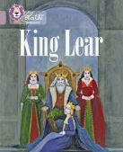






Big Cat reads

Slide 15
How do we support/encourage reading in school -
Reading records are monitored each week
Certificates will be awarded to children when they have read
Weekly monitoring is shown in our achievement assembly and on the newsletter
Reading groups and interventions – these do not count towards their 5 reads per week

Slide 16
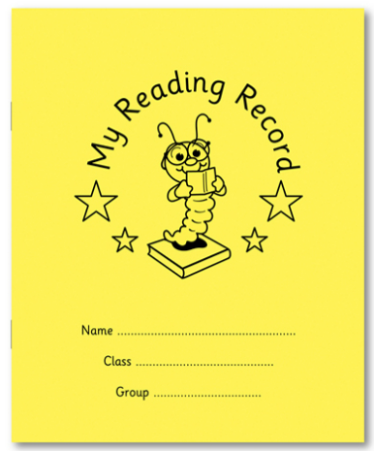
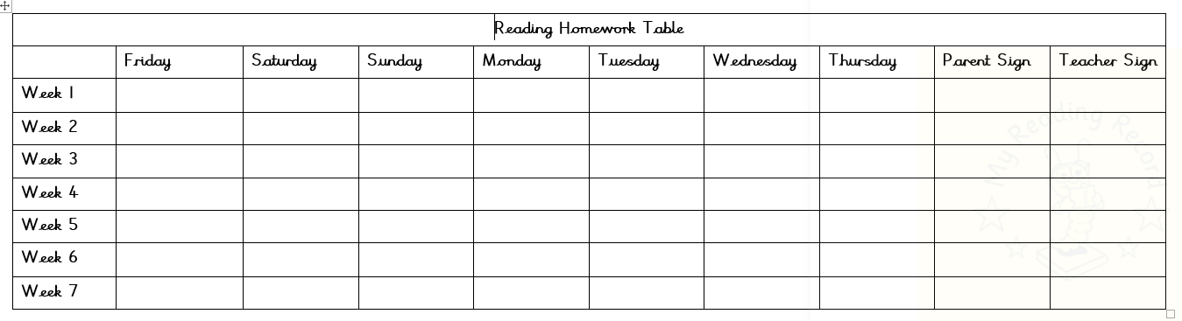
Recording Reading -

Slide 17
How can I help at home?
Encouraging reading at home and recording these in their reading records.
Letting children ‘have a go’ at decoding words.
Allowing children to get a word wrong and then correcting them rather than giving them the word straight away.
Asking questions about what they have read and predicting what might happen next. ‘How will… react to …?’ and ‘What does this mean for…?’
Encouraging children to extending their answers- asking: ‘Why do you think that?’ and ‘What makes you think that will happen next?’
Look up definitions of words when your child doesn’t know what a word means to broaden their vocabulary.

