Slide 1

Science Workshop 2025

Slide 2
Purpose
Give you an opportunity to work with your child(ren) in school
Gain an understanding of what the Pucklechurch Science curriculum looks like
Show you how we help the children develop their scientific understanding

Slide 3
What do we do at school?
Sessions like today
Enhance our curriculum with the use of technology
Plan engaging, investigation focussed sequences of learning that incorporate cross-curricular elements
Offer investigations that are linked to a particular type of enquiry
Children encouraged to ‘think like scientists’ to fully immerse themselves in science and achieve the ‘working scientifically’ objectives

Slide 4
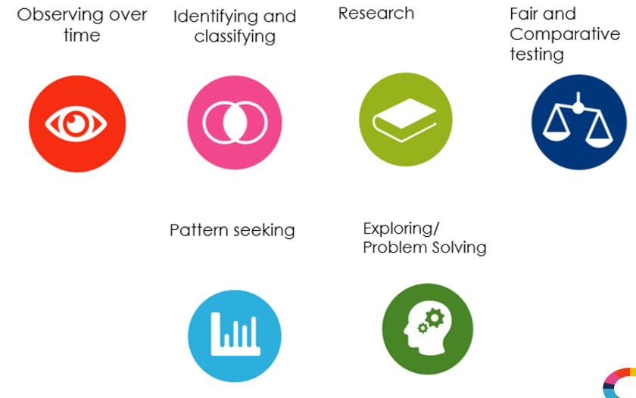
Types of enquiry…

Slide 5
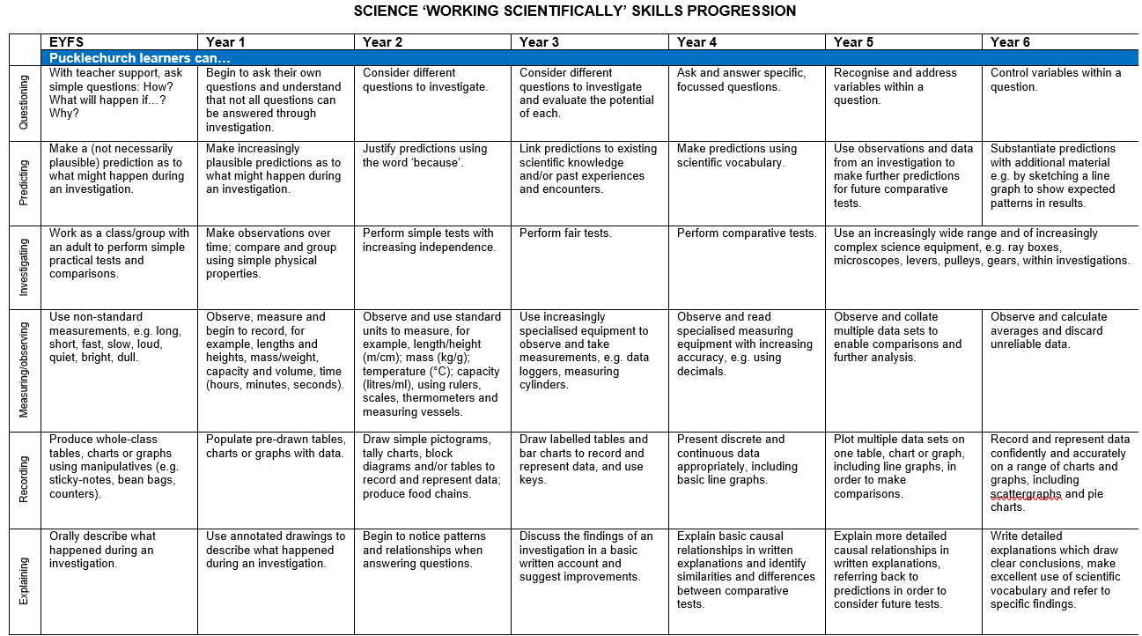
Working scientifically objectives…

Slide 6
What does the science sequence of lessons look like?
Throughout the year, the children will be given opportunities to do complete…
Enquiry lessons where the children can explore the new concept and make their own discoveries while using a range of resources
Research lesson where the children are given the opportunity to use the internet and books from the library to find out their own facts
Writing lessons where the children can showcase their writing skills in a cross-curricular context, often writing up the facts that they have researched as part of the unit into a factual report.
Investigation lessons where the children will focus on one of the types of enquiry and will use a variety of the working scientifically skills
Data lessons where the children can use their maths skills to represent the data from their investigation in a year group appropriate way
Further cross curricular opportunities such as researching scientists to further the children’s knowledge of the timeline of historical events.

Slide 7
Our curriculum…
EYFS
Understanding the world…
Seasonal changes
Plants
Life cycles
Minibeasts
Understand where certain animals and plants live/ grow.

Slide 8
Our curriculum…
Year 1
Seasonal changes
Animals, including humans
Everyday materials
Plants

Slide 9
Our curriculum…
Year 2
Living things and their habitats
Uses of everyday materials
Plants
Animals, including humans

Slide 10
Our curriculum…
Year 3
Plants
Rocks and soils
Animals, including humans
Light
Forces and magnets

Slide 11
Our curriculum…
Year 4
States of matter
Living things and their habitats
Animals, including humans
Sound
Electricity

Slide 12
Our curriculum…
Year 5
Living things and their habitats
Animals, including humans
Properties and changes of materials
Earth and Space
Forces

Slide 13
Our curriculum…
Year 6
Electricity
Light
Animals, including humans
Living things and their habitats
Evolution and Inheritance

Slide 14
In class…
In class today, you will see children taking part in an array of different science investigations.
The children will be focussing on different ‘working scientifically’ objectives and types of enquiry.
Enjoy the activities!

