Slide 1
Timestables and Spellings parent workshop

Slide 2
Timestables

Slide 3
Times tables -
Times Tables are at the heart of mental arithmetic, which in itself helps form the basis of a child’s understanding and ability when working with number. Once the children have learnt the times tables and related divisions by heart, they free up their working memory allowing them to progress far more confidently – and efficiently – through a wide range of more advanced calculations. At Pucklechurch Primary, we believe that through a variety of interactive, visual, engaging and rote learning techniques, most children can achieve the full times tables knowledge required by the end of Year 4.

Slide 4
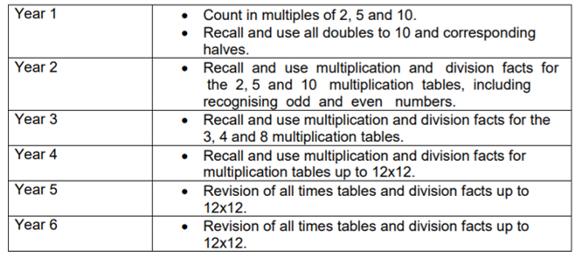
Times Table progression

Slide 5
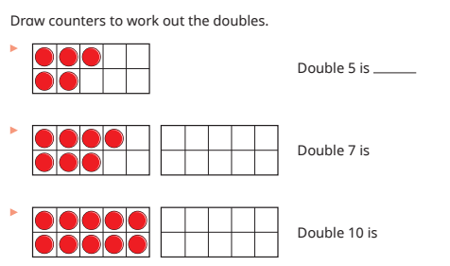
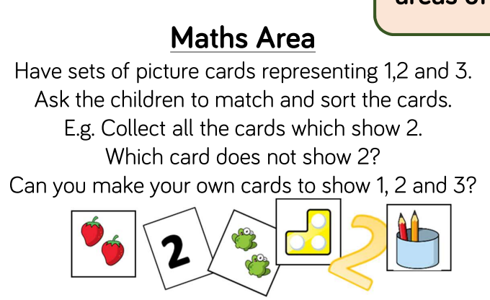
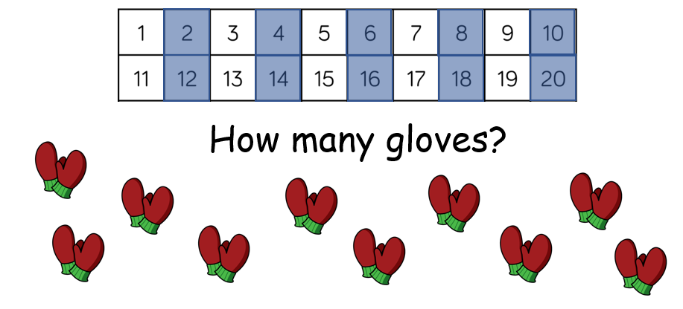
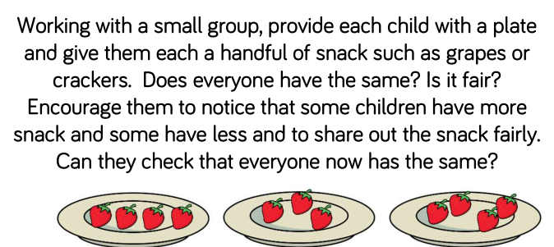
Pre- timestables

Slide 6
How do children learn times tables?

Slide 7
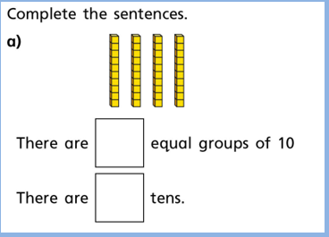
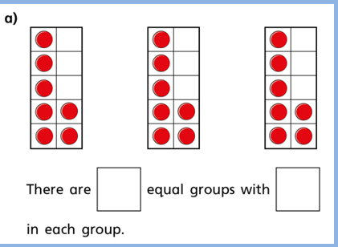
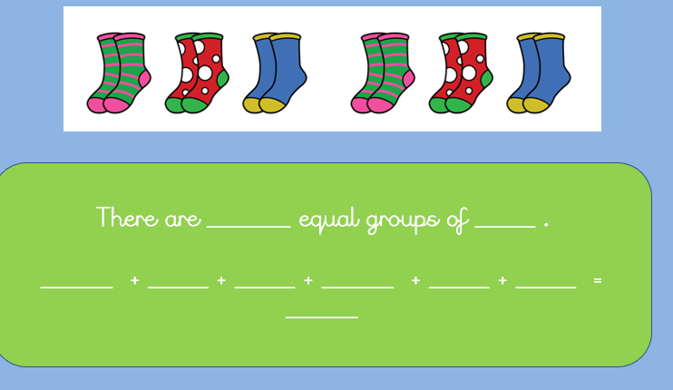
Groups

Slide 8
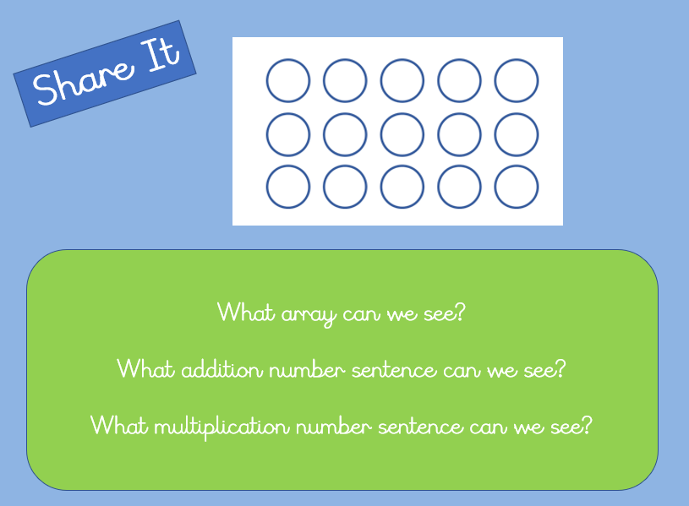
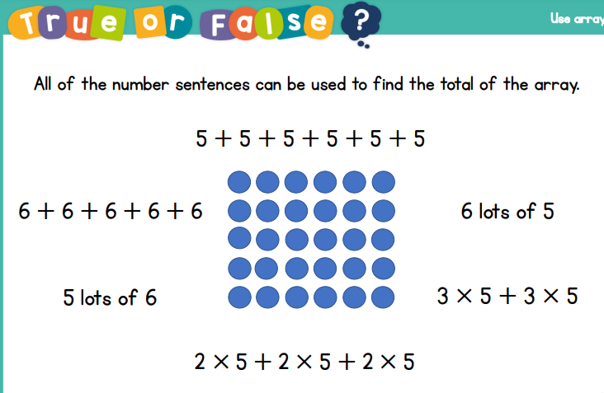
Arrays

Slide 9
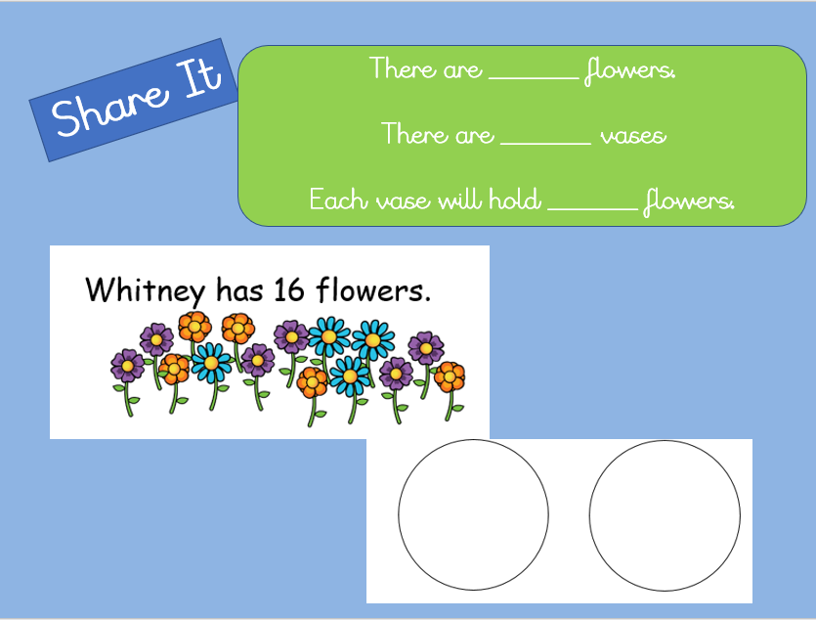
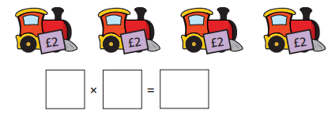
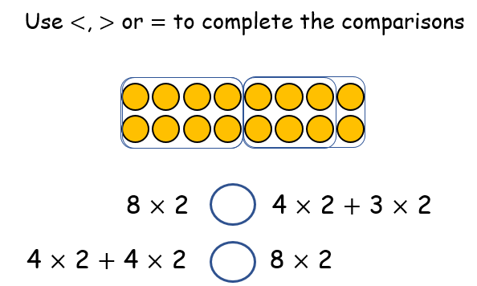
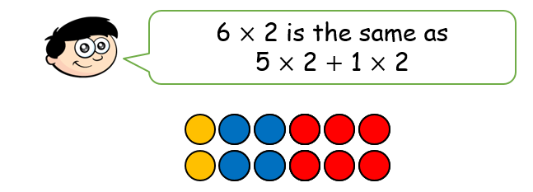
Reasoning

Slide 10
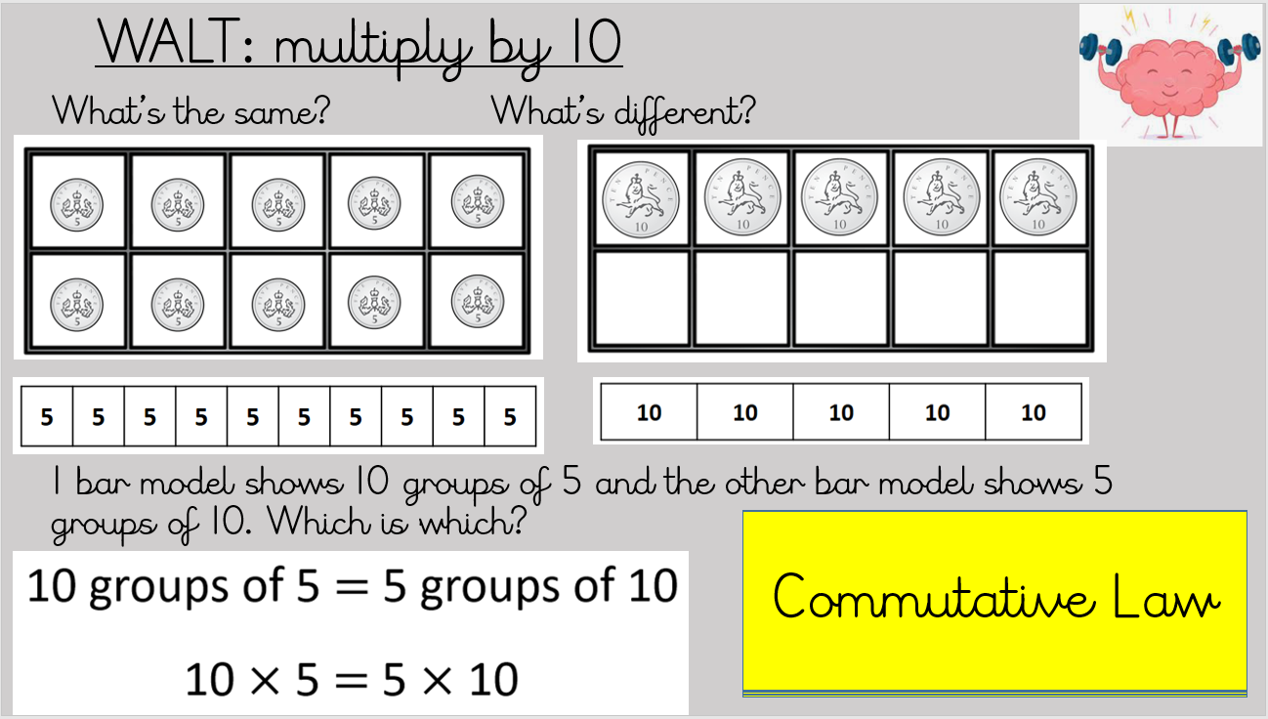
Commutative Law

Slide 11
How do we teach children to remember times tables?

Slide 12

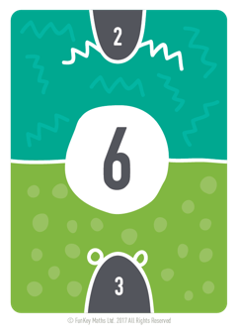
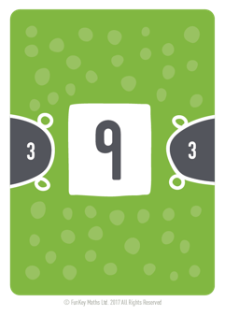
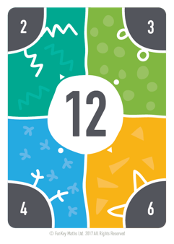
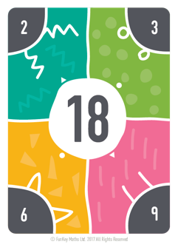
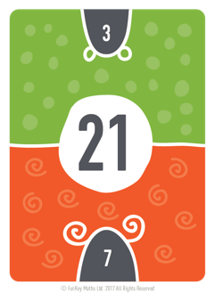
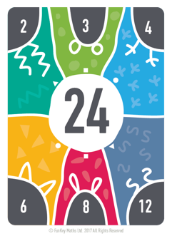
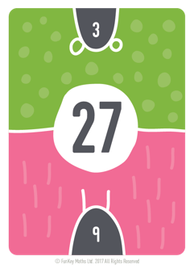
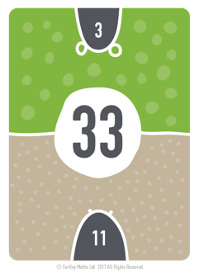
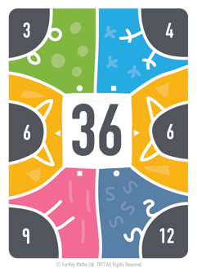
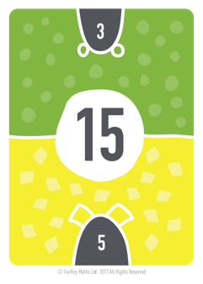
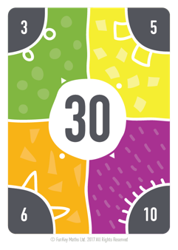
Step counting in 3s

Slide 13
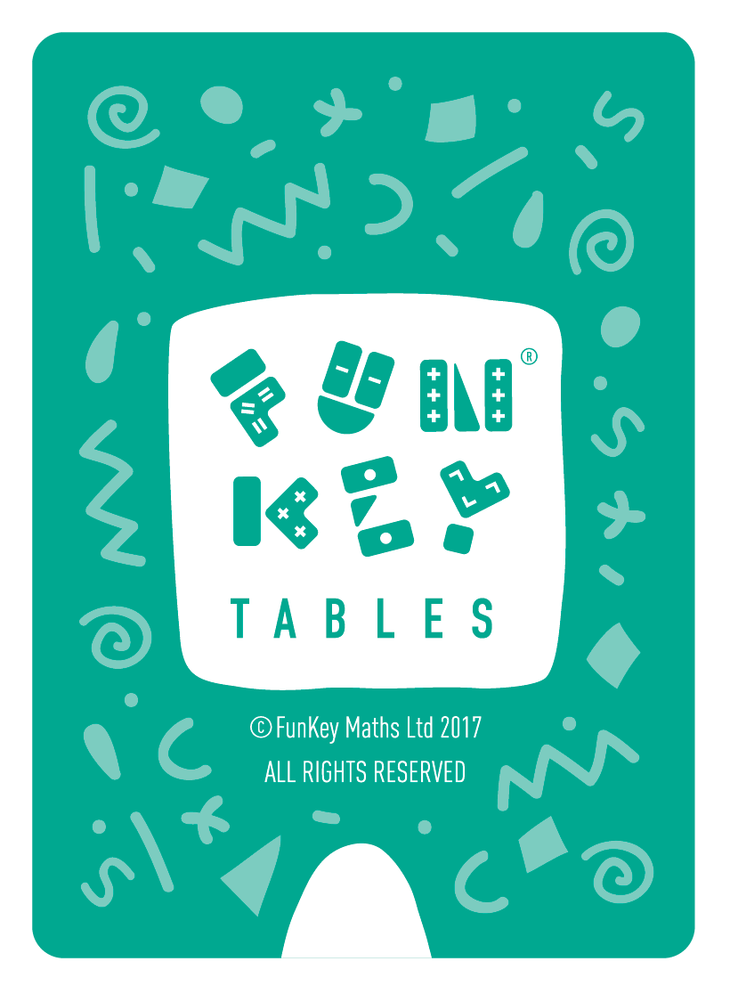
Step counting in 3s

Slide 14
Step counting in 3s

Slide 15
Step counting in 3s

Slide 16
Step counting in 3s

Slide 17
Step counting in 3s

Slide 18
Step counting in 3s

Slide 19
Step counting in 3s

Slide 20
Step counting in 3s

Slide 21
Step counting in 3s

Slide 22
Step counting in 3s

Slide 23
Step counting in 3s

Slide 24
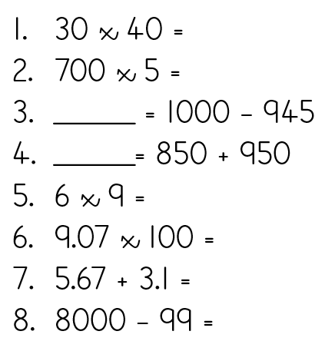
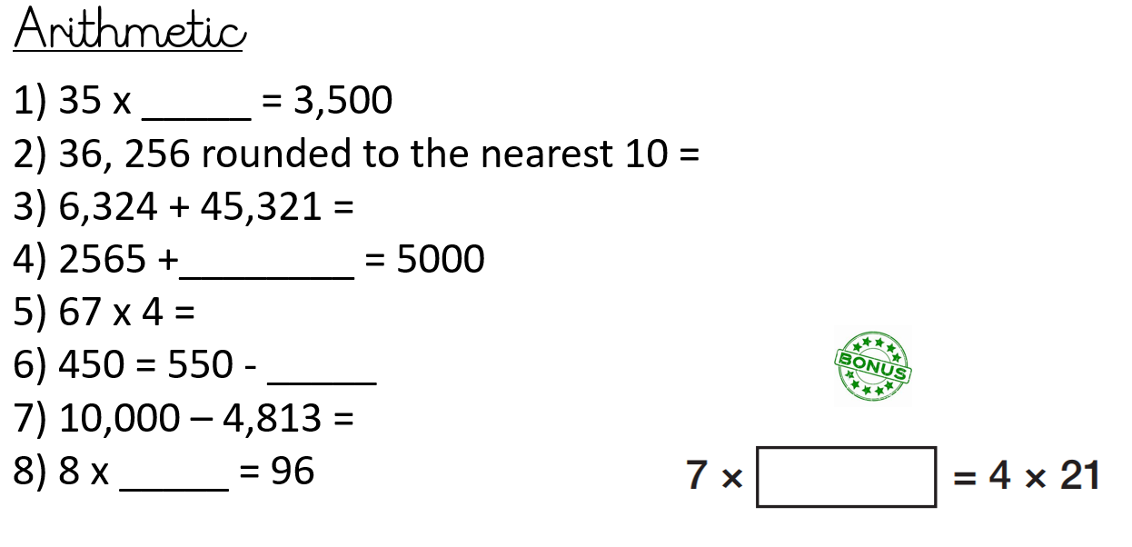
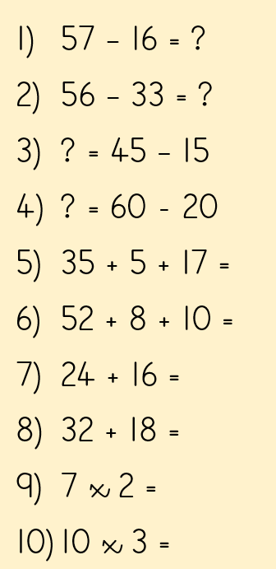
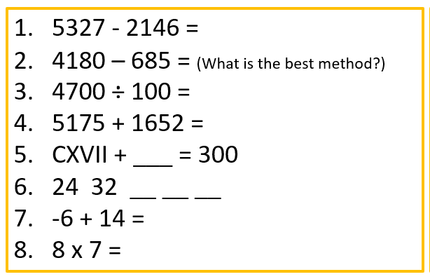
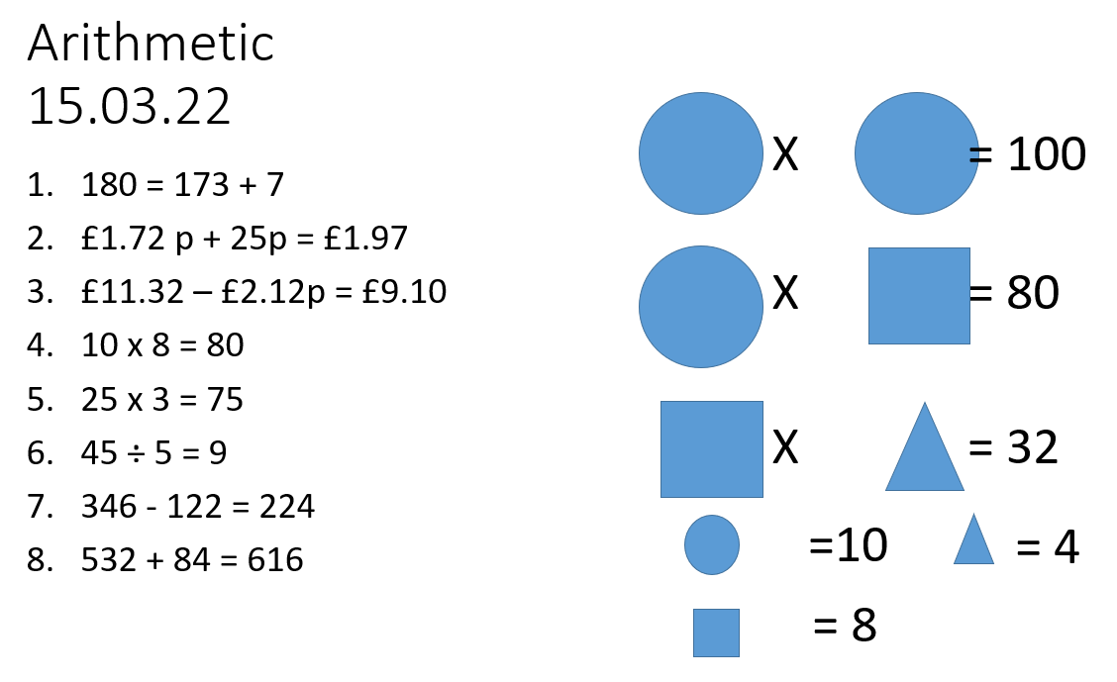
Arithmetic

Slide 25
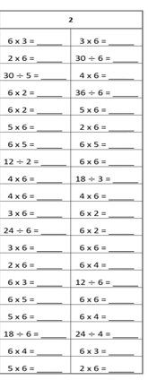
Rehearsal tests

Slide 26
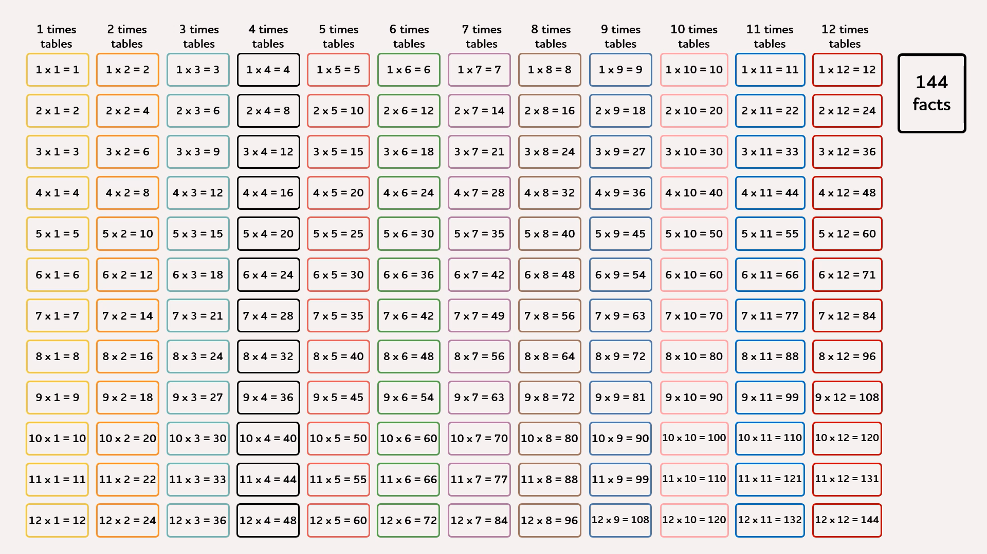

Slide 27
55
Facts

Slide 28
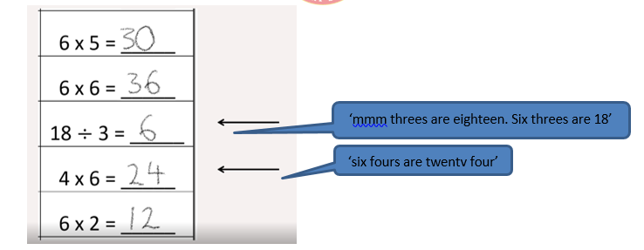
Marking the test
It is in marking the tests together that the children are ‘trained’ to automatically refer to the fact as one of the 36 essential facts and apply their knowledge of the commutative law to ‘flip’ the fact so that it becomes one of the 36 facts we learn.

Slide 29
In this order…
The order in which times tables should be introduced is:
2 x table
10 x table
5 x table
3 x table
4 x table
8 x table
6 x table
9 x table
7 x table
11 x table
12 x table

Slide 30
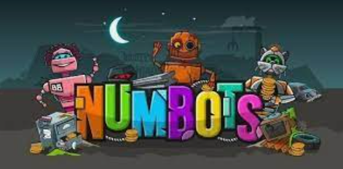

Helping at home

Slide 31
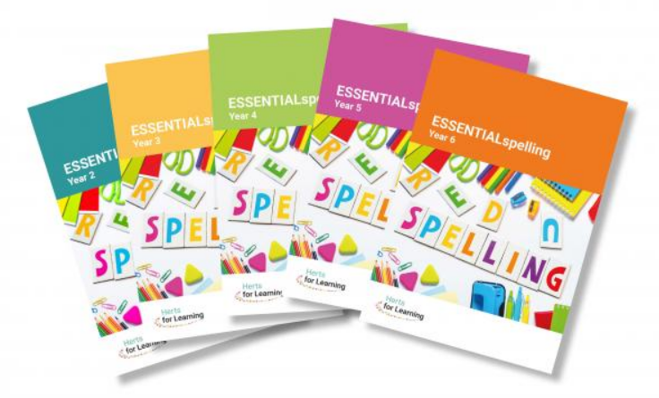
Spellings

Slide 32
What do we use?
We use ESSENTIAL spellings
This spelling resource is different to other spelling schemes. It focuses more on the teaching of spelling so that children understand how to apply patterns, strategies and knowledge to other words and not just a list of words given for that week.
It also provides links to prior knowledge and tracks back to related objectives so that teachers can give targeted support to children who are not yet able to spell words from their year group programme of study.
ESSENTIALspelling empowers children to build words- they are shown how to become spellers for life, rather than remember spellings for a week.

Slide 33
Why do we recap phonics and previous rules taught?
ESSENTIALspelling places an emphasis on the Review stage of the teaching sequence. This is not ‘what did we learn last week?’ but instead: “What do we already know that might help us to spell words in this sequence?” which gives pupils the chance to build connections between existing knowledge and new knowledge
Our Phonics Scheme of Little Wandle links with ESSENTIAL spelling to continue with phonics which helps spell 25% of their words. This provides consistency through their spelling journey.

Slide 34
How do we learn the new rules?
The children follow the scheme in the order that the rules are presented – following on from the previous year and using guidance from the National Curriculum
The Practise and Apply sections give children the opportunity to rehearse spelling patterns and use them in context.
Then there are two further sections: Minor Gaps and Major Gaps. Every sequence shows teachers how to support the children who have small gaps in their previous learning -as well as those who have not secured the foundations needed for any given sequence
The Practise sections suggest activities that can be undertaken independently by children during the lesson or even at home. The emphasis here is on exploration and word building, rather than practising a prescribed list of words.
The Apply sections follow a regular pattern of children discussing their learning and spelling words in the context of short dictations. There might be a suggestion of an extended writing activity to challenge the children to choose and use words independently and in context.

Slide 35
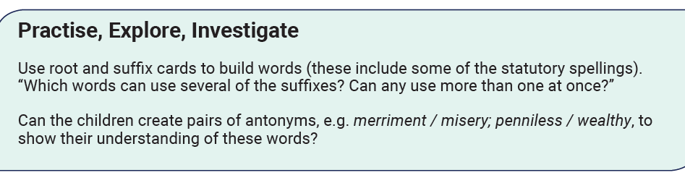
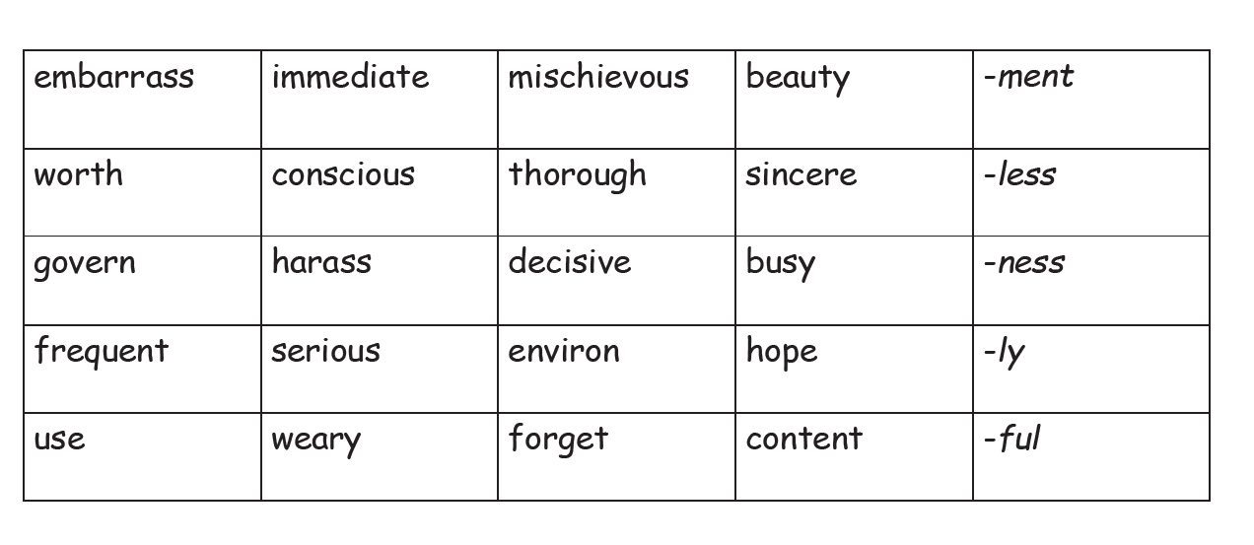
How can children practise their spellings?
There are a range of activities children can use to practise spellings
Pattern spotting
Add the correct suffix or prefix
Putting words into sentences
Word families and classes

Slide 36
Phonics

Slide 37
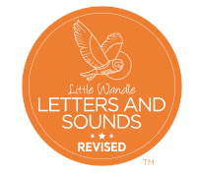
Phonics at Pucklechurch
We follow a phonics scheme called Little Wandle
This follows a process similar to Essential Spellings Review, Teach, Practise, Apply
Children practise applying their phonics sounds to their reading and writing
Phonics sounds are broken up into 6 phases which are taught at different parts throughout the year
We use ‘grow the code’ to help children choose the correct phoneme

Slide 38
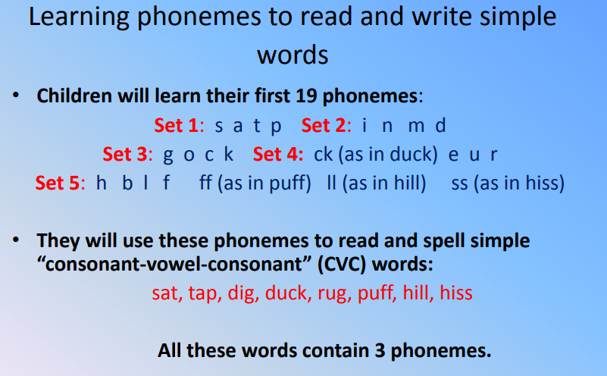
Phase 2

Slide 39
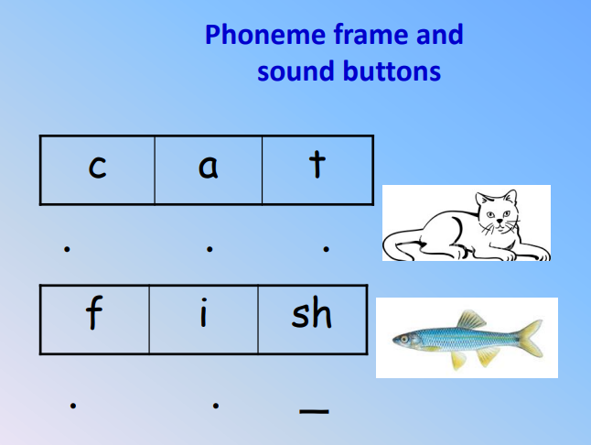

Slide 40
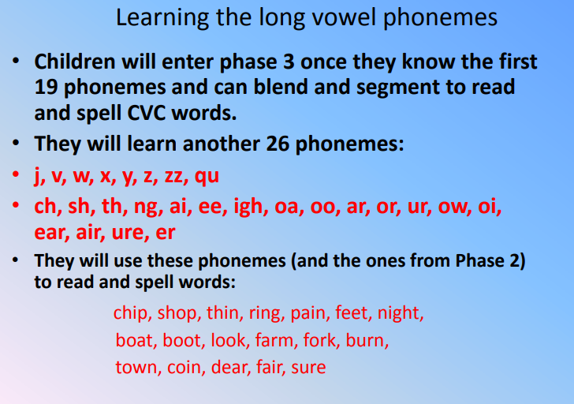
Phase 3

Slide 41
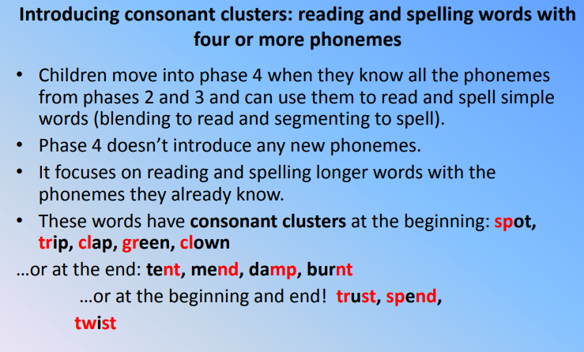
Phase 4

Slide 42
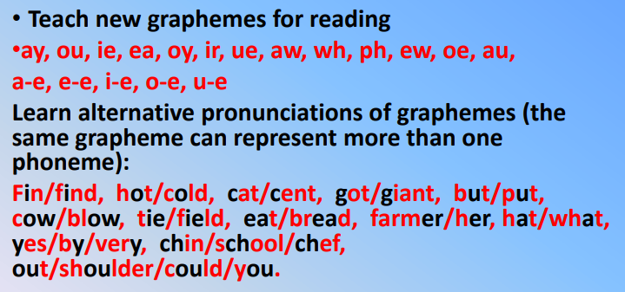
Phase 5

Slide 43
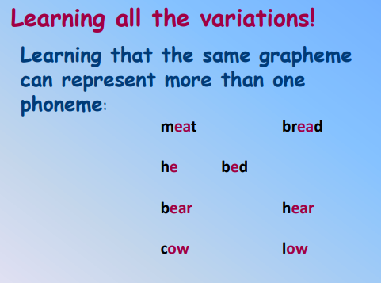
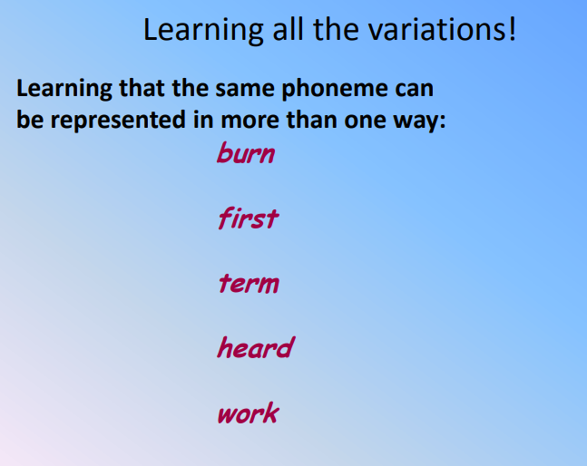
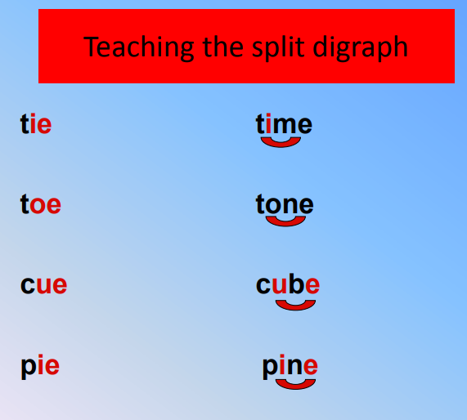

Slide 44
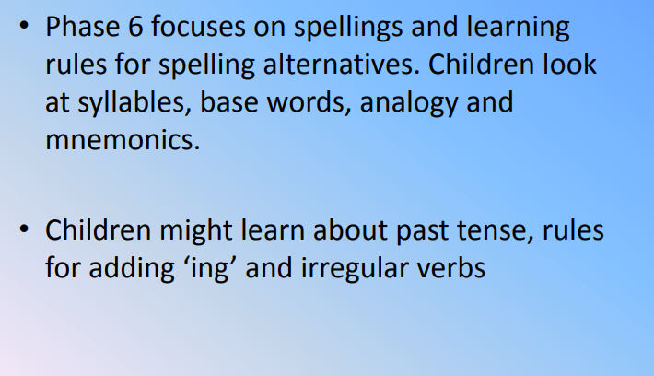
Phase 6

